Slide 1


کارگاه عملی
آپاچی دروید
دیتابیس‌های تحلیلی

Slide 2


مجتبی بنائی
1. مدیر واحد دیتای شرکت خدمات مدیریت صباتامین
2.مدرس دوره‌های مهندسی داده موسسه نیک‌آموز
3.موسس و سردبیر وب سایت مهندسی داده (BigData.ir)
4. دانشجوی دکترای نرم افزار دانشگاه تهران
(گروه تحقیقاتی پایگاه داده دانشگاه)
5. مشاوره و تدریس اصول طراحی سامانه‌های مقیاس پذیر
6. و...

Slide 3
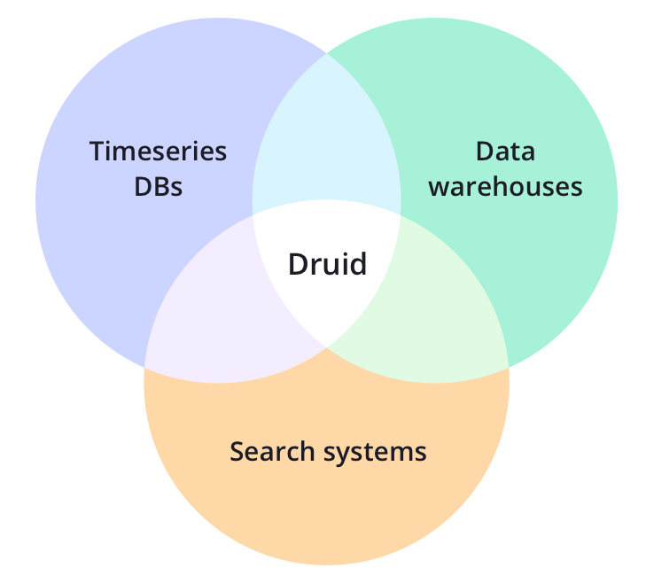
دروید - تعریف رسمی سایت آپاچی
Apache Druid is an open source distributed data store.
Druid’s core design combines ideas from data warehouses, timeseries databases, and search systems to create a high performance real-time analytics database for a broad range of use cases.
Druid merges key characteristics of each of the 3 systems into its ingestion layer, storage format, querying layer, and core architecture.
آپاچی دروید یک دیتابیس تحلیلی توزیع شده برای ذخیره و پردازش بلادرنگ حجم عظیم جریان‌های ورودی داده است.

Slide 4
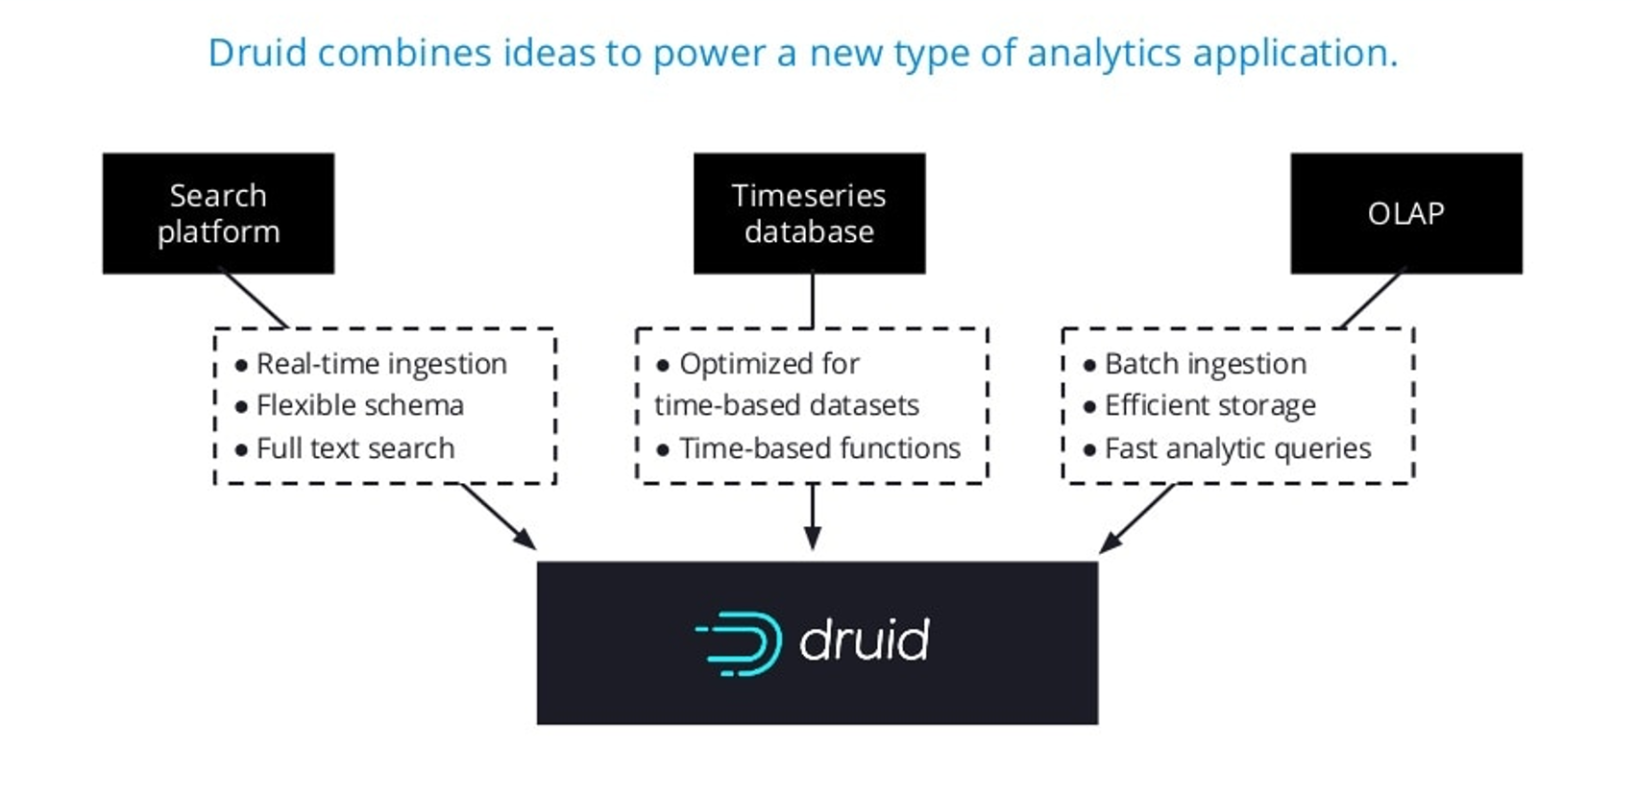
دروید - در یک نگاه

Slide 5
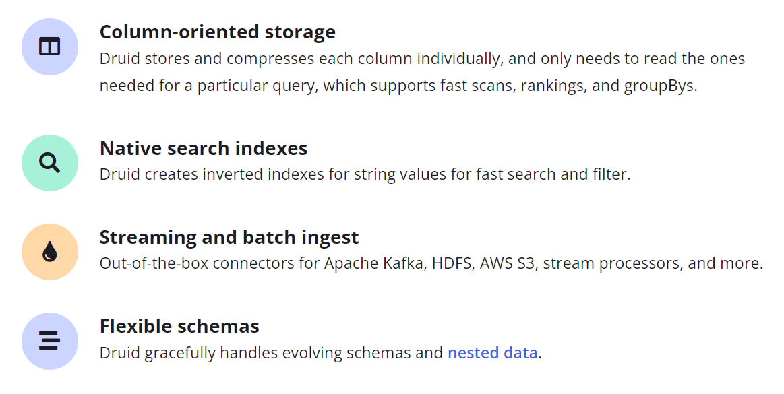
قابلیت‌های کلیدی

Slide 6
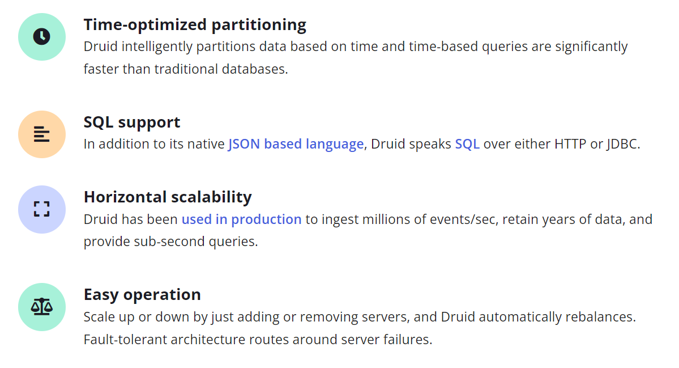
قابلیت‌های کلیدی

Slide 7
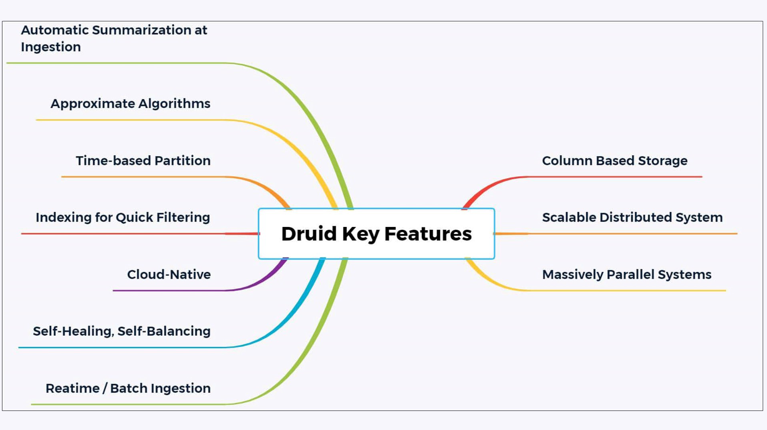
قابلیت‌های کلیدی

Slide 8
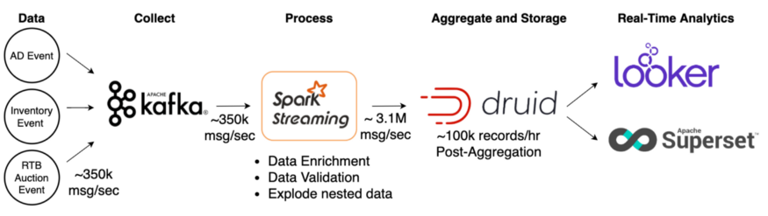

دروید در عمل - GumGum
Optimized Real-time Analytics using Spark Streaming and Apache Druid
Jun 2, 2020

Slide 9
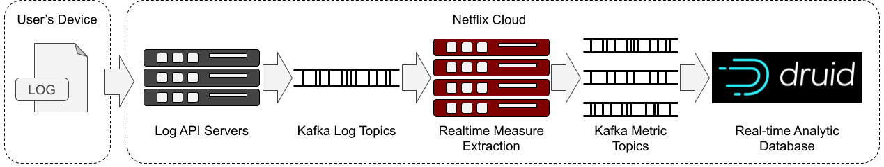

دروید در عمل - Netflix
How Netflix uses Druid for Real-time Insights to Ensure a High-Quality Experience - Mar 3,2020

Slide 10
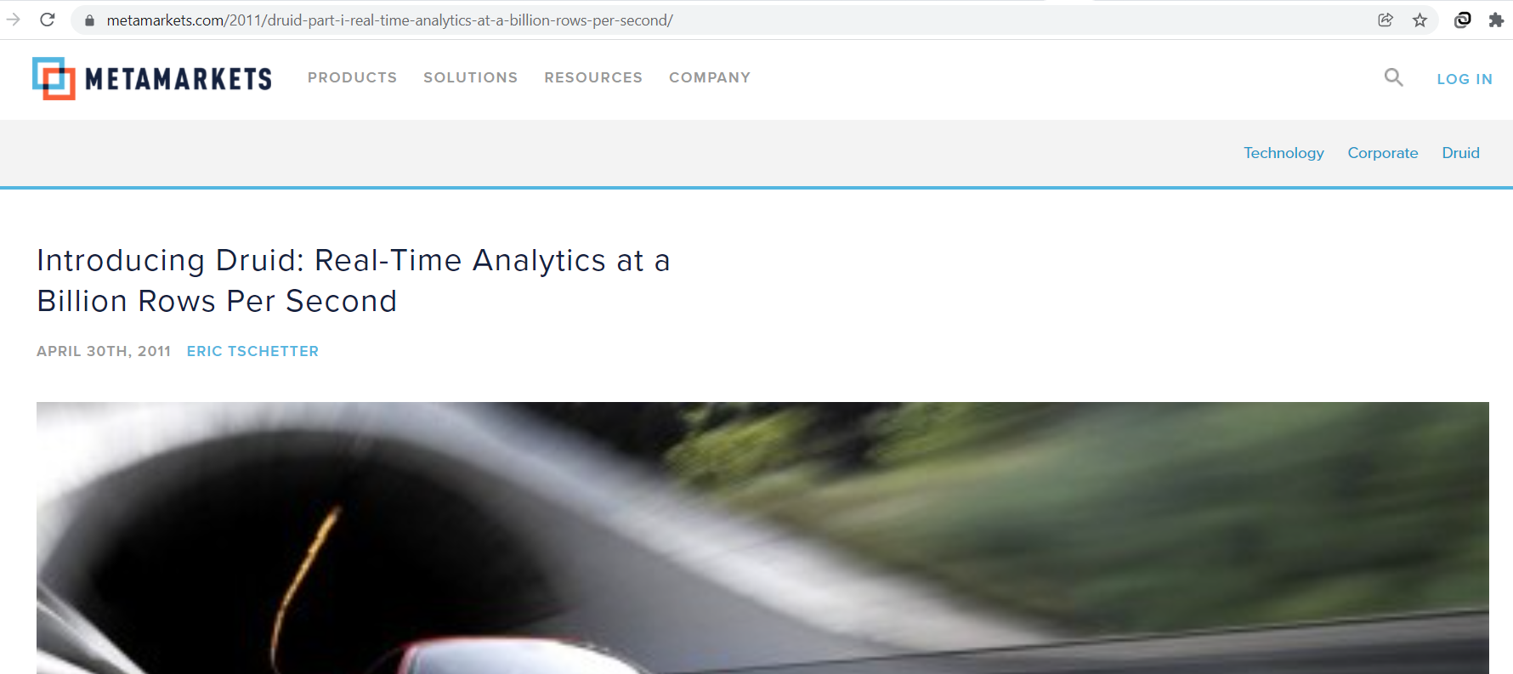
تولد دروید - 2011
Initially, Apache Druid became an open-source software in 2012 under the GPL license, thereafter in 2015 changed to Apache 2 license and in 2018 joined the Apache Software Foundation as an incubating project.

Slide 11
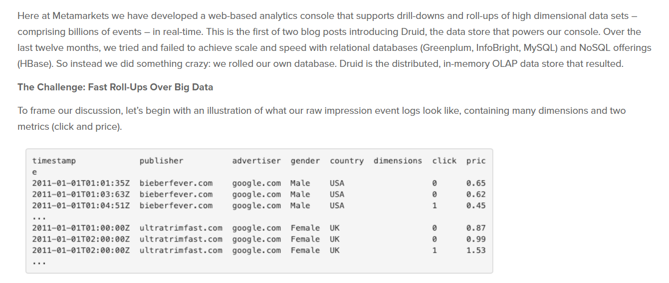
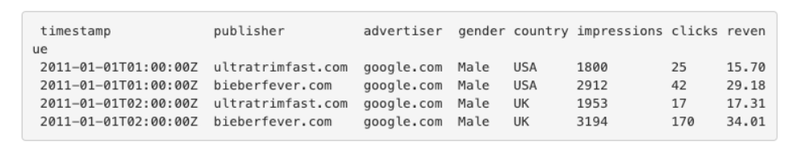
تولد دروید - 2011
Roll-Ups

Slide 12
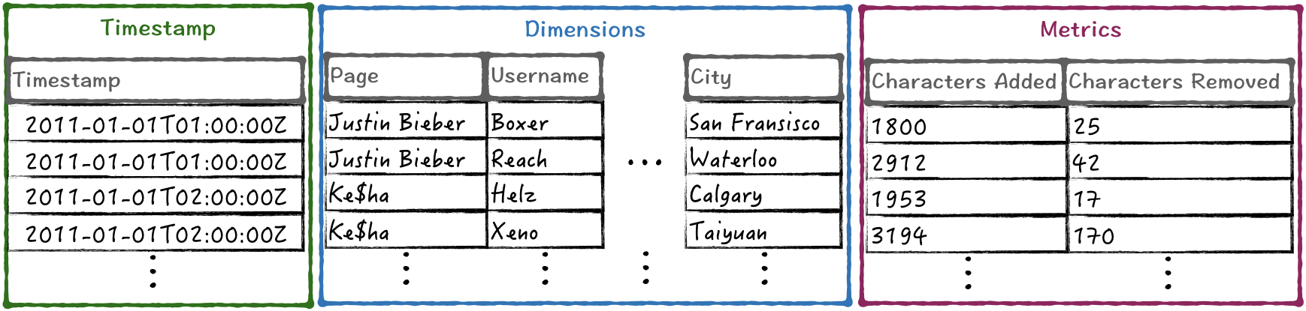
ساختار داده‌ها در دروید
Every dataset is stored in datasources (similar to tables in relational DB)
Timestamp serves as primary partition column
Dimensions are used to filter, query/groupBy
Metrics are values that can be aggregated and must be numeric

Slide 13
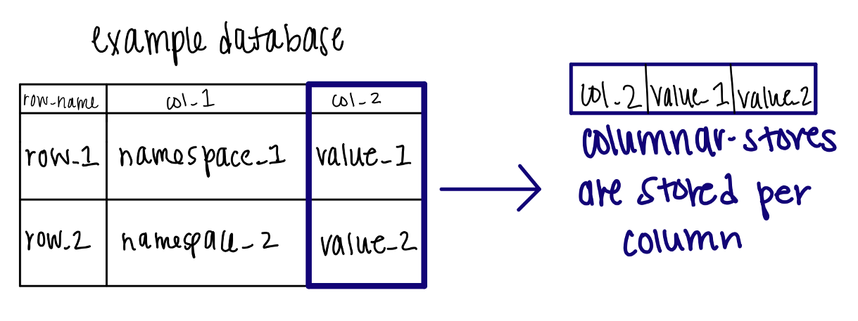
چرا دروید این‌قدر سریع است؟
For storage efficiency and fast filtering over dimensions of data, Druid stores data in a column-oriented compressed format .Therefore, it can deal with data redundancy and at the same time it uses an efficient format for performing queries over multi-dimensional aggregations and groupings.
To answer a query, it only loads the exact columns that are required.
Each column is stored optimized for its particular data type.
To provide fast filtering and searching across multiple columns, Druid uses state-of-the-art compressed bitmap indexes (for details see CONCISE and Roaring).
The data are being partitioned based on time, thus timeseries queries are significantly faster than traditional databases.
Druid provides out-of-the-box algorithms for approximate count-distinct, approximate ranking, and computation of approximate histograms and quantiles.

Slide 14
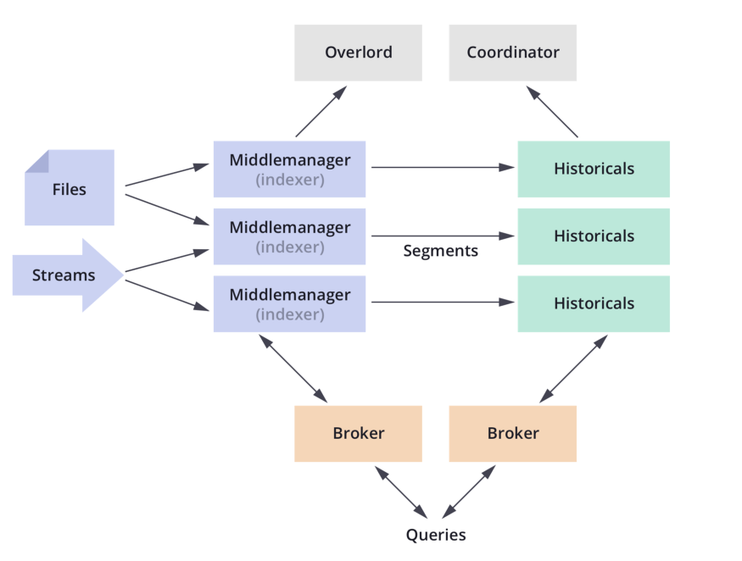
معماری دروید
Fault-tolerant architecture

Slide 15
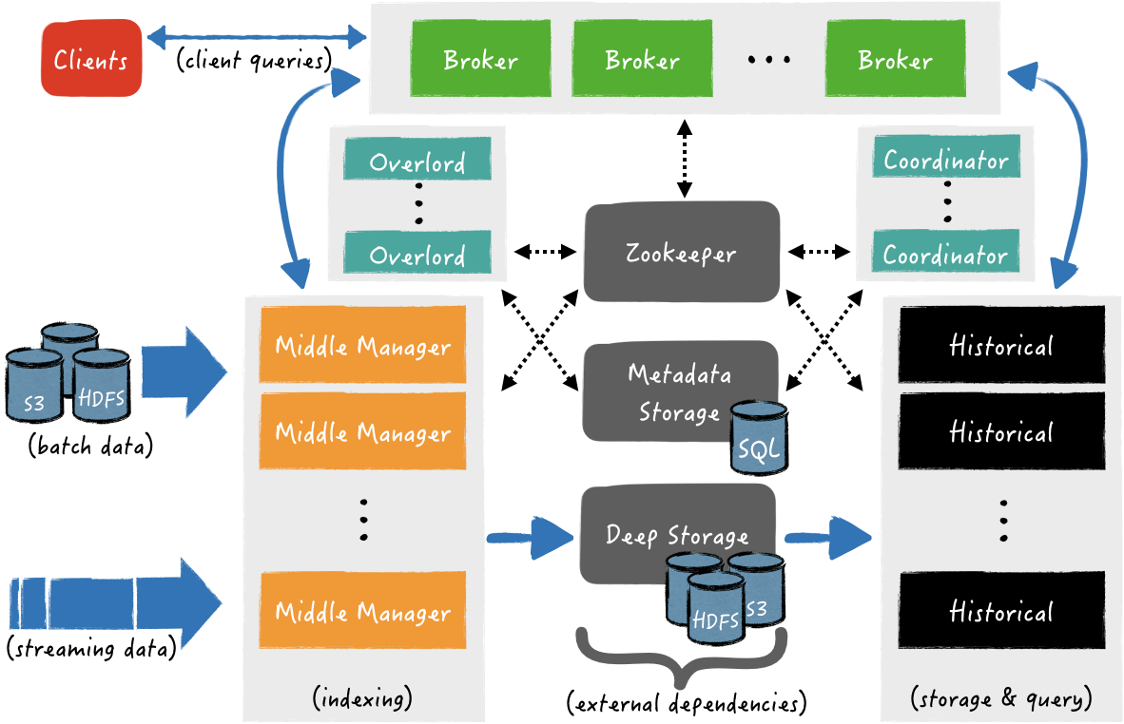
معماری دروید
نگاهی دقیق‌تر

Slide 16
معماری دروید- وابستگی‌های خارجی
Deep Storage: it can be any distributed file system or object storage, like Amazon S3, Azure Blob Storage, Apache HDFS (or any HDFS compatible system), or a network mounted file system. The purpose of the deep storage is to persist all data ingested by Druid, as a backup solution and at the same time to be available to all Druid components and clusters, when it is needed.
Metadata Storage: is backed by a traditional relational database system, e.g., PostgreSQL or MySQL. All metadata are available to any Druid component. There are various types of metadata in Druid, some are related to the persisted segments in deep storage, for example paths of segment files, their timestamp, their version, etc., other may related to external systems like the ingested partition offsets from a Apache Kafka topic and the rest are related to metadata of various internal processes (e.g., in which segments are being created now).
ZooKeeper: is used for internal service discovery, coordination, and leader election.

Slide 17
معماری دروید- مولفه‌های اصلی
Coordinator: Manages data availability on the clusters
Overlord: For controlling the assignment of data ingestion workloads
Broker: This is for handling queries from external clients
Router: Used to route requests to brokers, coordinators and overlords
Historical: For storing the data that can be queried
Middle manager: This is responsible for ingesting data There are three types of servers.
یک گروه بندی متفاوت
Master: This is for running the coordinator and overlord processes. It also manages data availability and ingestion.
Query: This runs broker and router processes (optional). It is used for handling queries from external clients.
Data: This runs the historical and middle manager processes. It is used to execute ingestion workloads.

Slide 18
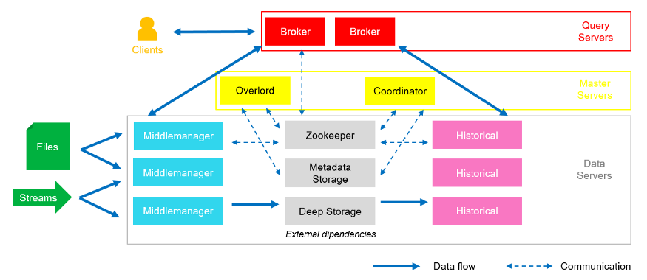
معماری دروید- مولفه‌های اصلی

Slide 19
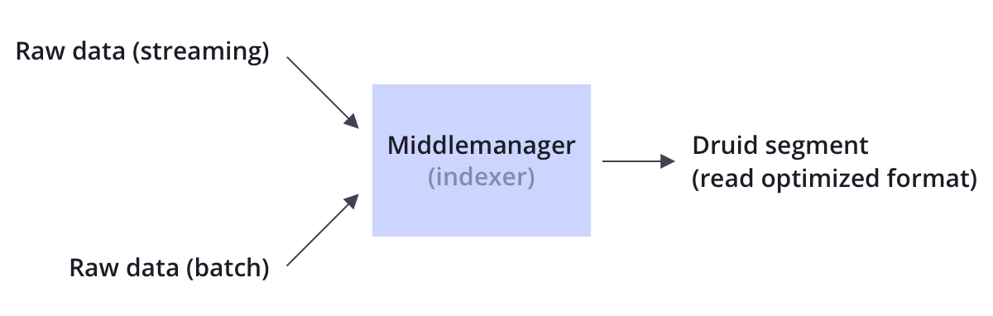
Data ingestion flow
Data ingestion flow is a two part process.
In the first part, Middle Managers are running indexing tasks that create and publish segments to Deep storage.
In the second part, the published segments are fetched from Deep storage by Historical processes, in order to be used in query answering.
بخش اول - ایجاد سگمنت‌ها

Slide 20
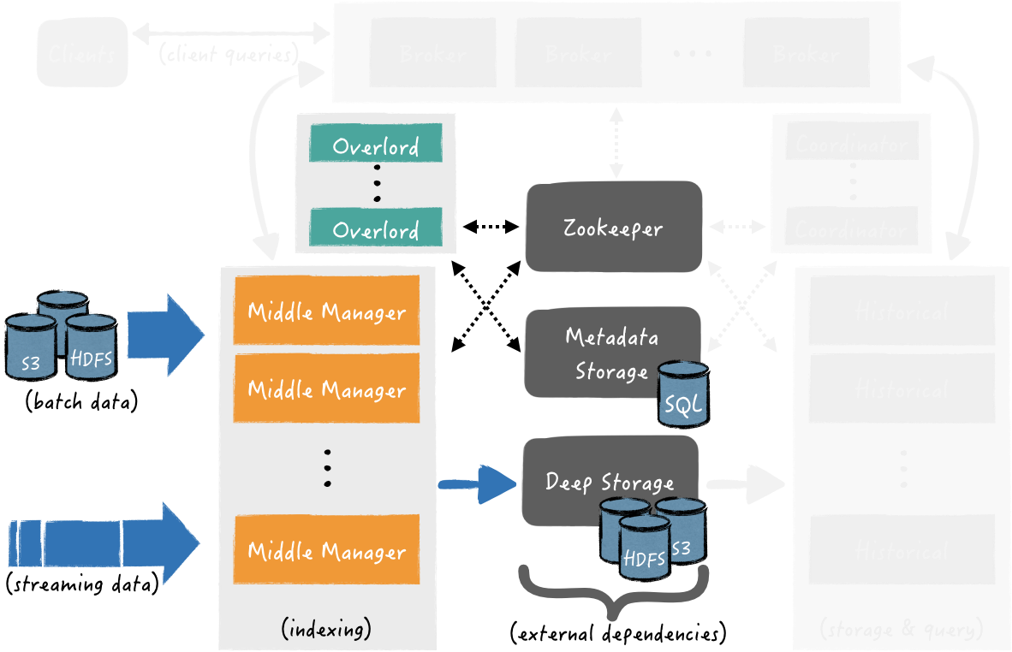
Data ingestion flow - part 1
Indexing: Segments Creation and Publishing

Slide 21
Data ingestion flow - part 1
At the beginning of an indexing task, a new segment is created. The input data of a segment may originate by a real-time stream (e.g., a Kafka topic) or by a batch of files (e.g., CSV files in HDFS)
the currently creating segments from tasks that are real-time are immediately queryable
Indexing: Segments Creation and Publishing
A task is completed either when it has indexed the maximum number of records per segment (e.g., five million records) or reached the desired rollup interval of time (e.g., hourly aggregates).
At this point, the segment is published by persisting its data to the Deep storage and its metadata to the Metadata store

Slide 22
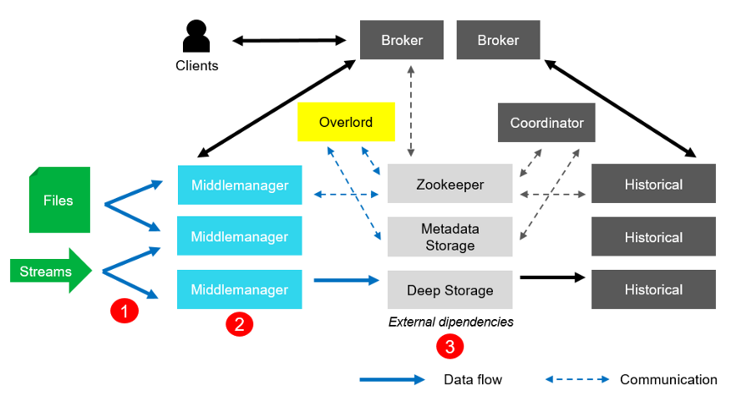
Data ingestion flow - part 1
In the indexing phase, at first data are gathered from the sources (1), then they are indexed and pre-aggregated (2) in order to create new segments and published (3) into the Deep Storage.

Slide 23
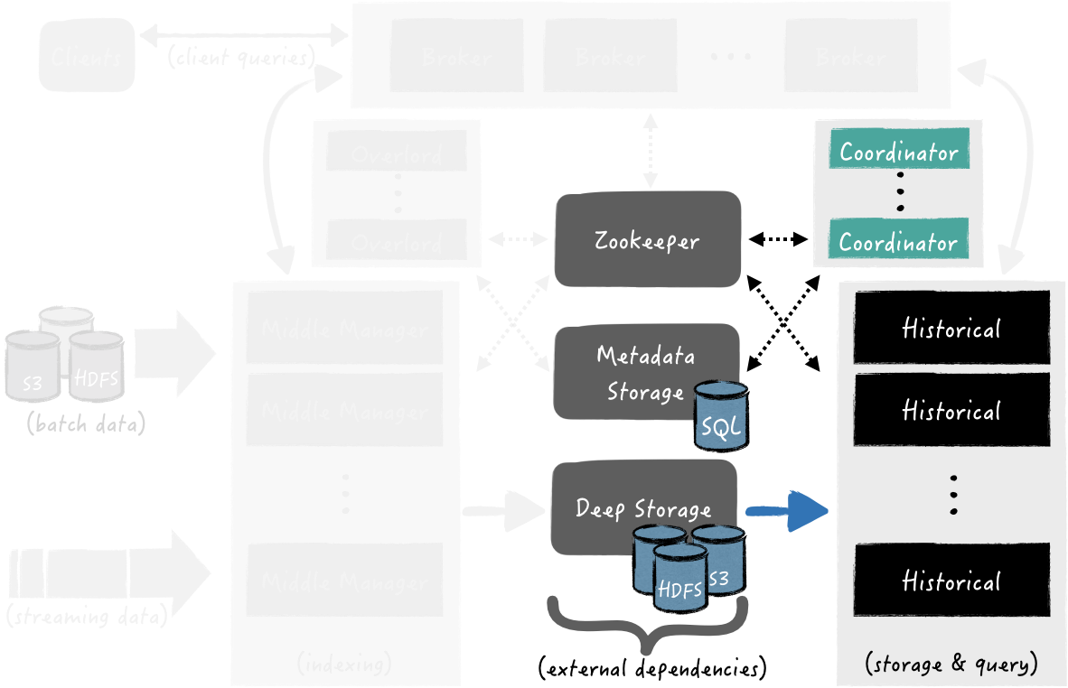
Data ingestion flow - part 2
Handoff: Published Segments
Fetching for Query Answering

Slide 24
Data ingestion flow - part 2
The Coordinator processes are periodically polling the Metadata store in order to find any newly published segments from data ingestion tasks.
Once a newly created segment is being discovered by a Coordinator process, it chooses which Historical process should fetch the segment from Deep storage
Handoff: Published Segments
Fetching for Query Answering
When the segment has been successfully loaded, the Historical process is ready to serve it for querying

Slide 25
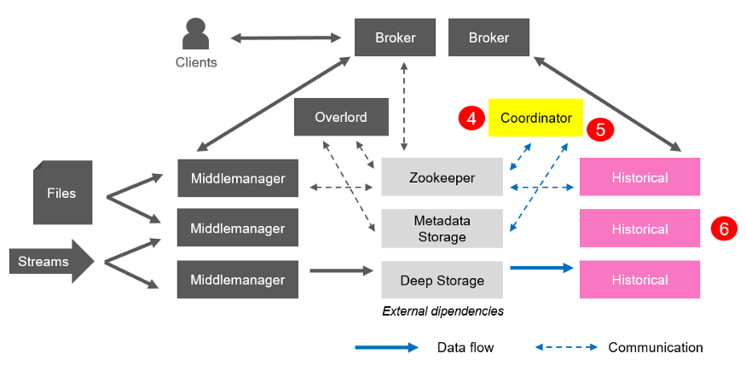
Data ingestion flow - part 2
In the fetching phase, since Coordinators are listening to Metadata Storage periodically for newly published segments (4), when one of them finds a segment that is published and used but unavailable, it chooses a Historical process to load that segment in memory and instructs that Historical to do so (5). At the end, the Historical performs its task and begins serving the data(6).

Slide 26
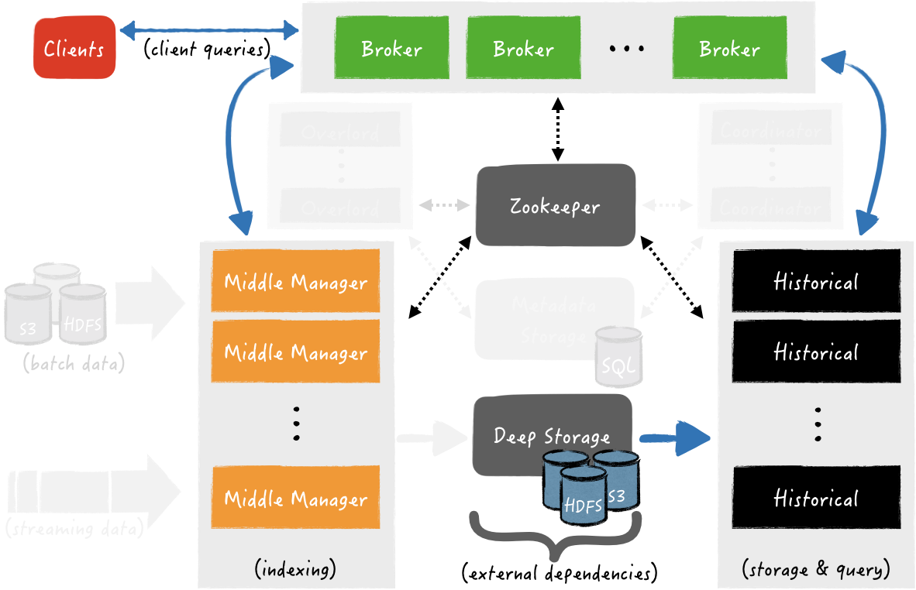
Query Answering
https://anskarl.github.io/post/2019/druid-part-1/

Slide 27
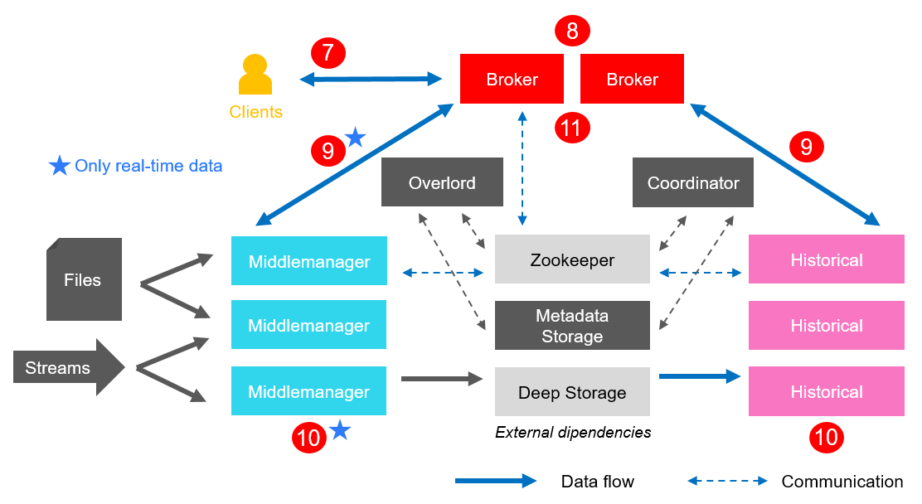
Query Answering
https://medium.com/data-reply-it-datatech/what-is-apache-druid-ad67bb8cd7f7

Slide 28
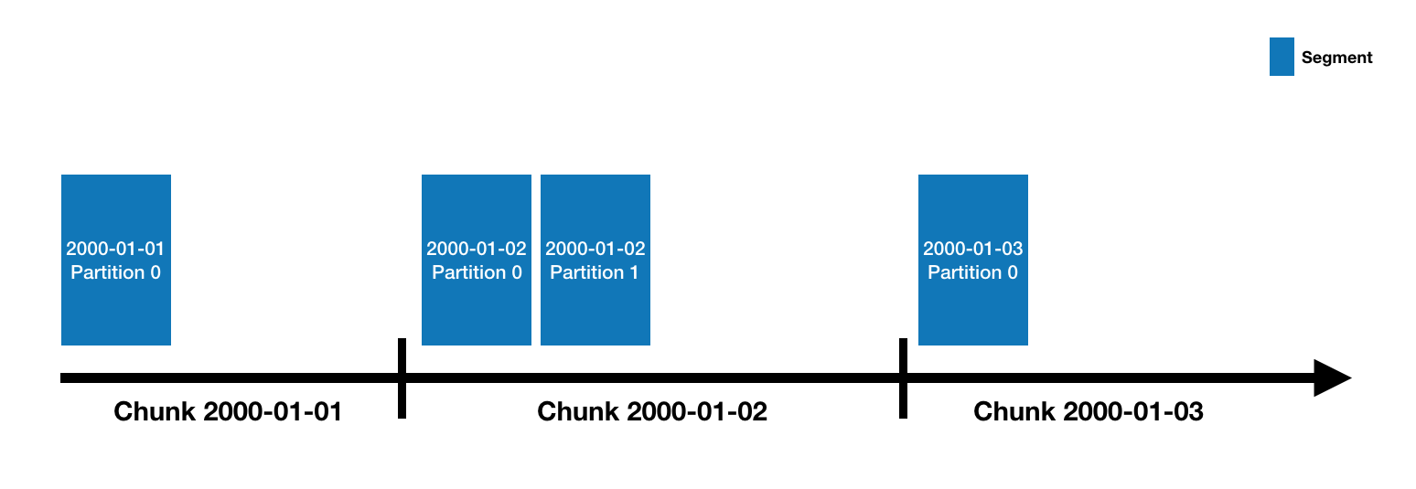
نگاهی دقیق‌تر به ساختار داخلی داده‌ها
- هنگام تعریف یک دیتاسورس، نحوه پارتیشنینگ داده‌ها را تعیین‌ می‌کنیم.
- پارتیشن بر اساس زمان انجام میشود. (بازه روزانه در مثال زیر)
بسته به ریزدانگی پارتیشن‌، بازه‌های زمانی به مجموعه‌ای از چانک‌ها تقسیم می شوند
هر چانک، به مجموعه‌ای از سگمنت‌ها تقسیم می‌شود

Slide 29
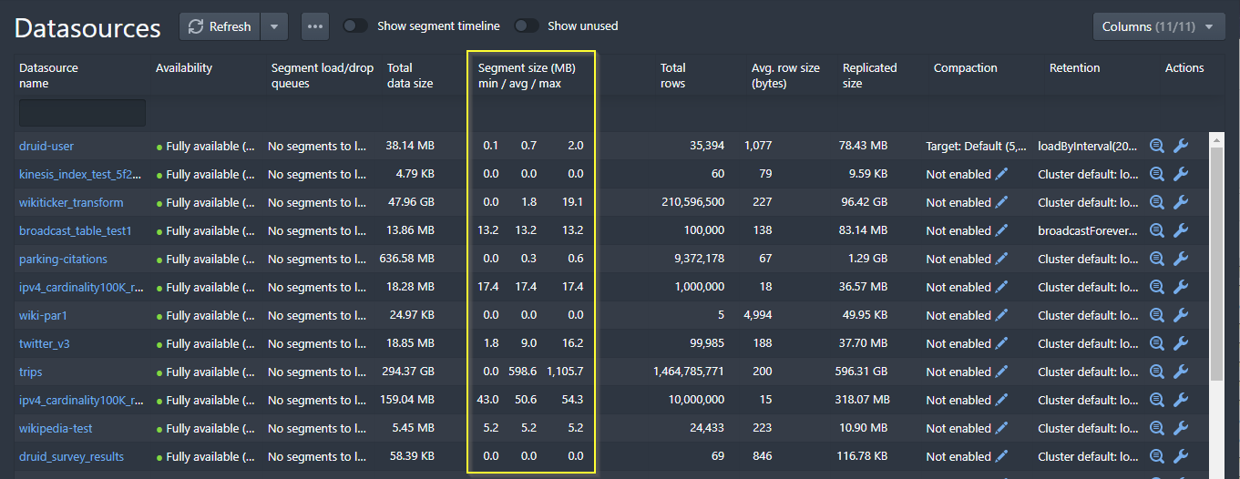
مشاهده آماره‌های مرتبط با سگمنت‌ها در واسط کاربری دروید

Slide 30
نامگذاری سگمنت‌ها
Segments all have a four-part identifier with the following components (_ is the separator):
Datasource name
Time interval (for the time chunk containing the segment; this corresponds to the segmentGranularity specified at ingestion time).
Version number (generally an ISO8601 timestamp corresponding to when the segment set was first started).
Partition number (an integer, unique within a datasource+interval+version; may not necessarily be contiguous).
Segments with partition number 0 (the first partition in a chunk) omit the partition number

Slide 31
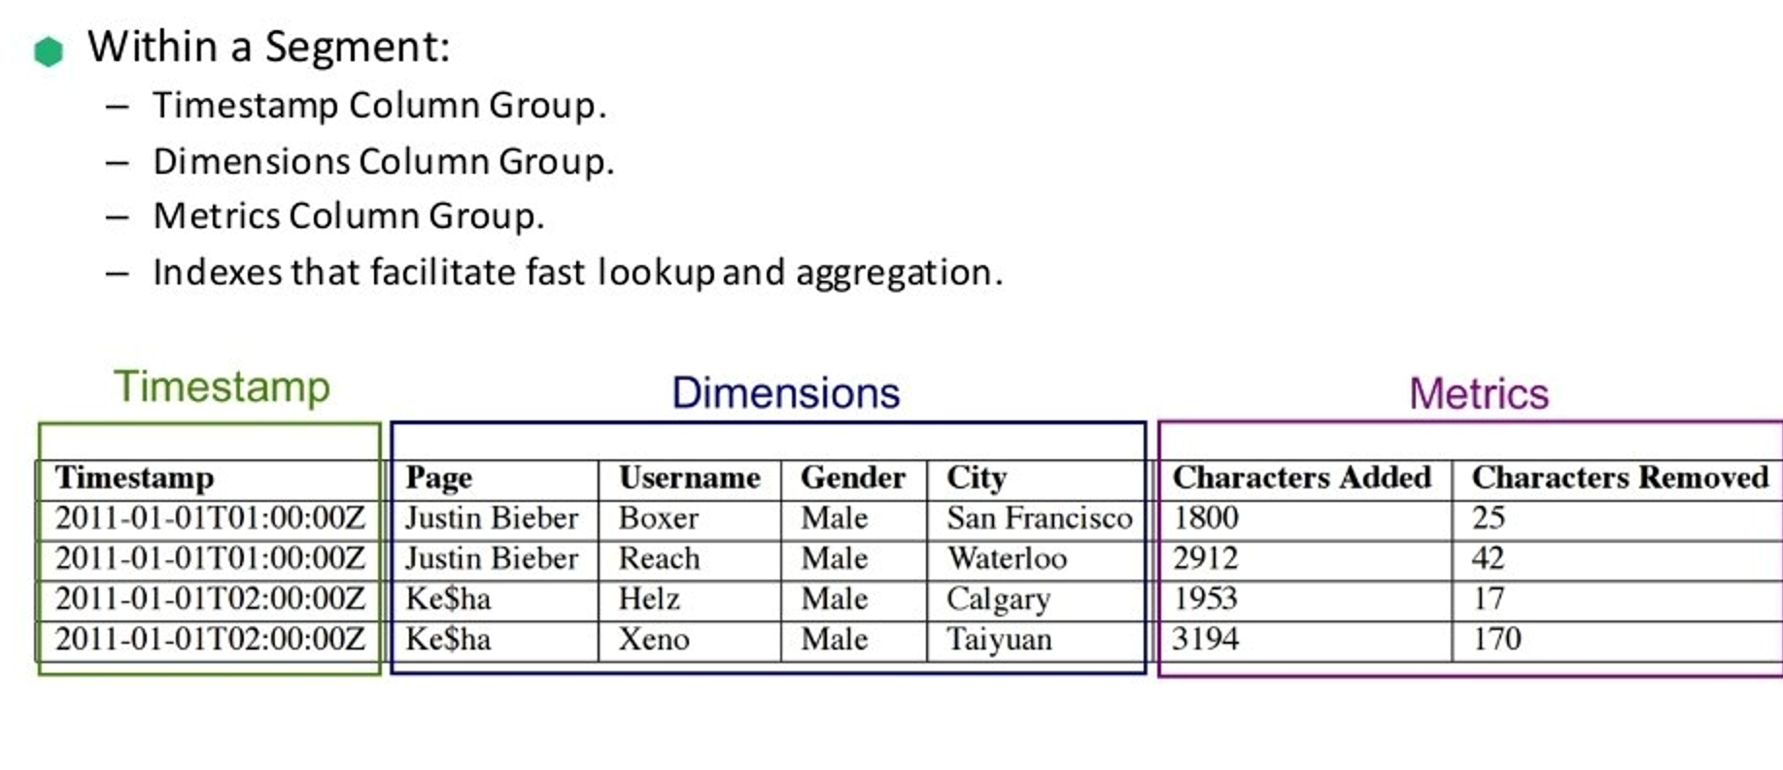
داده‌های موجود در هر سگمنت

Slide 32
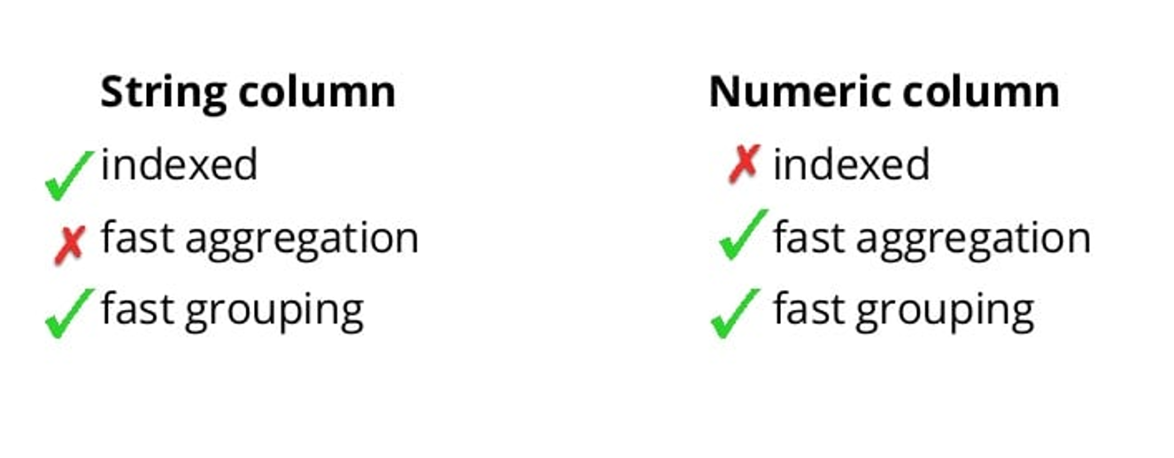
انتخاب نوع ستون‌ها

Slide 33
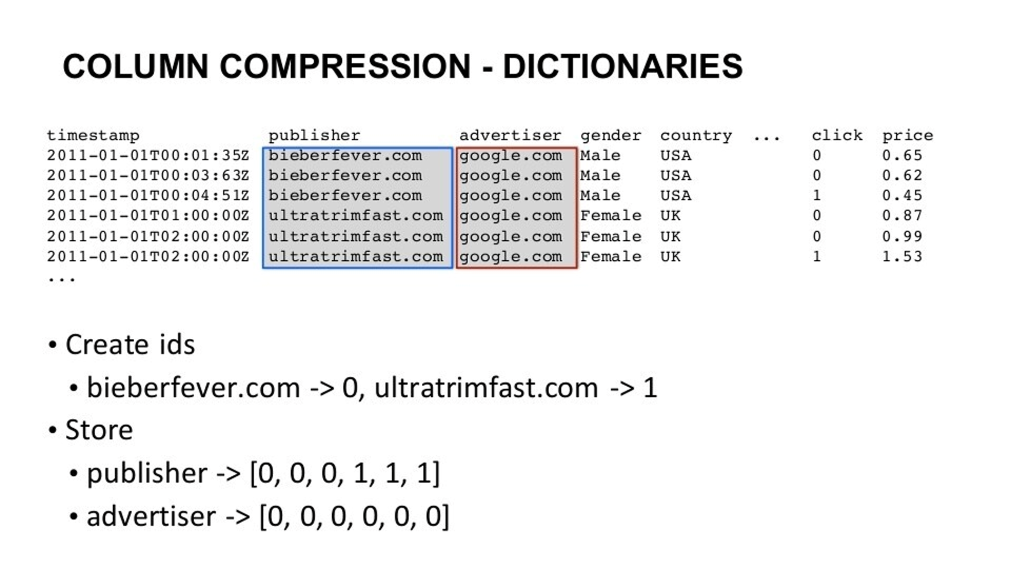
مروری بر نحوه ایندکسینگ و فشرده‌سازی داده‌ها

Slide 34
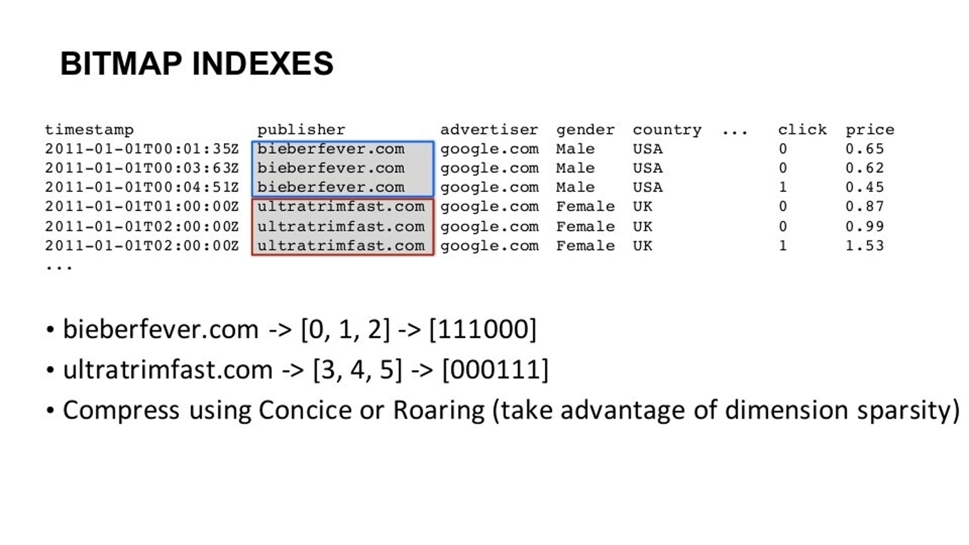
مروری بر نحوه ایندکسینگ و فشرده‌سازی داده‌ها

Slide 35
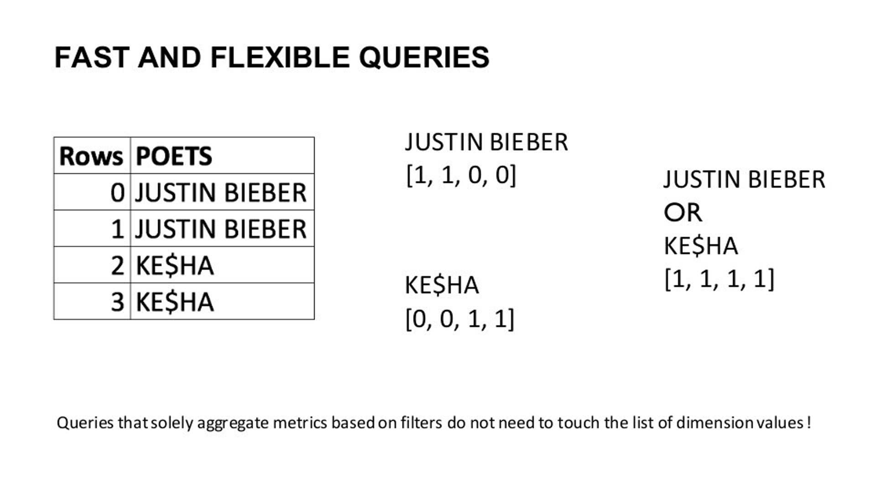
مروری بر نحوه ایندکسینگ و فشرده‌سازی داده‌ها

Slide 36
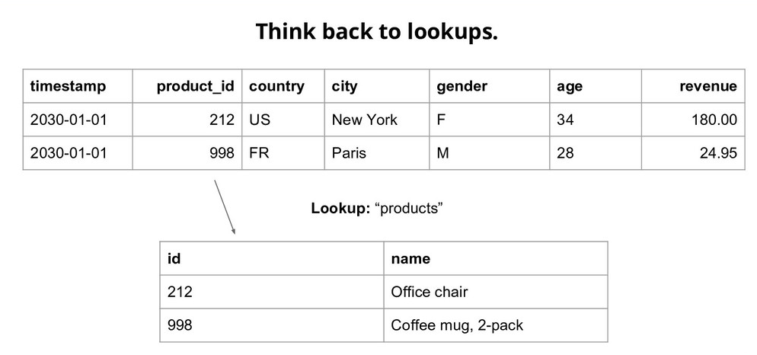
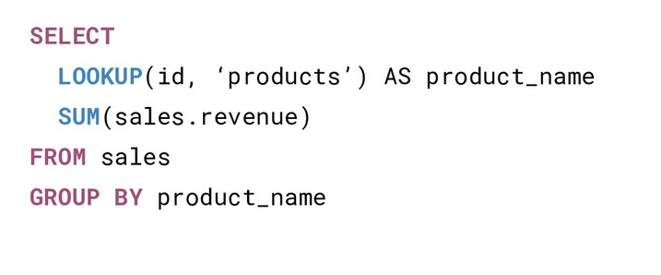
لوکاپ‌ها : راهی برای جلوگیری از جوین‌های غیرضروری

Slide 37
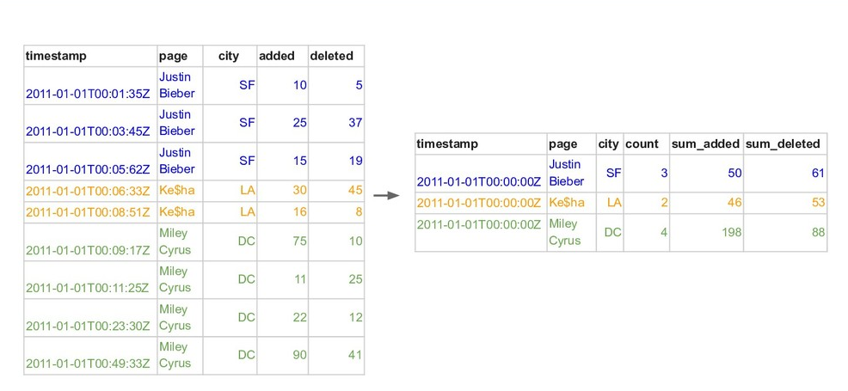
Rollup - تجمیع داده‌ها هنگام ورود

Slide 38
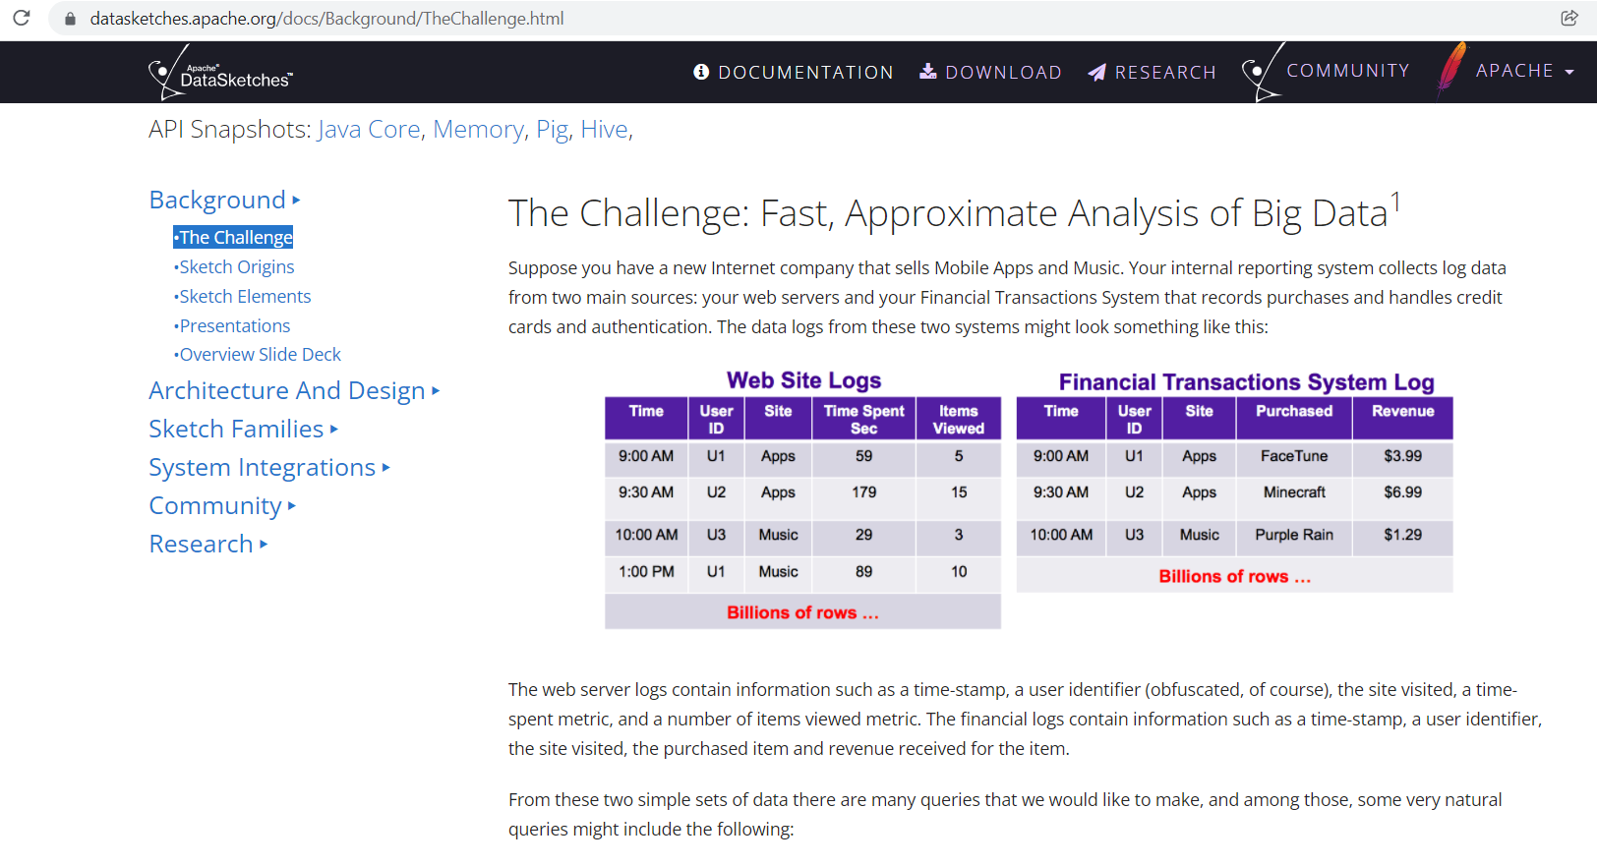
الگوریتم‌های تقریبی - بنیاد آپاچی

Slide 39
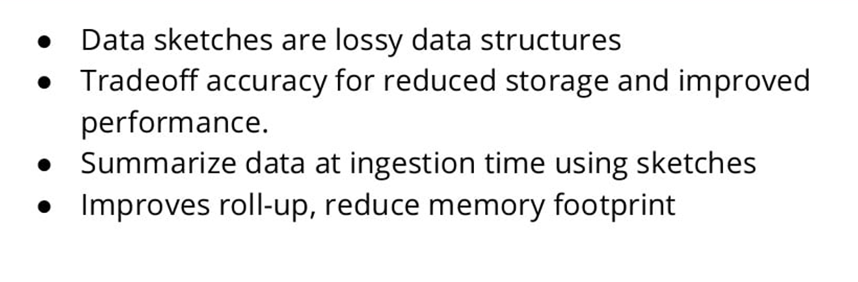
الگوریتم‌های تقریبی

Slide 40
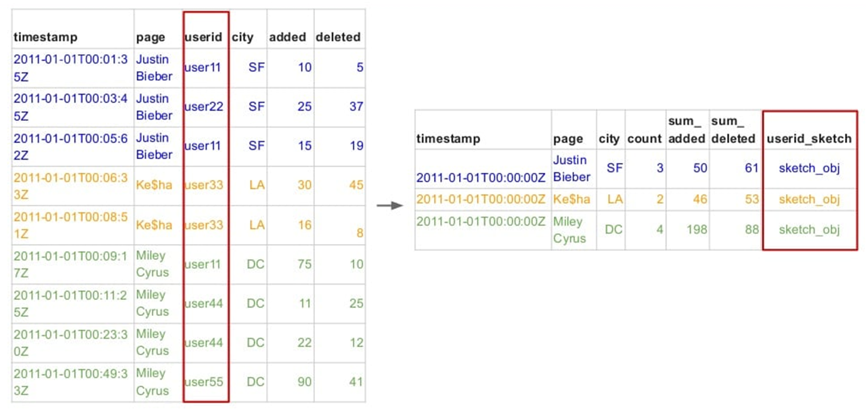
الگوریتم‌های تقریبی

Slide 41
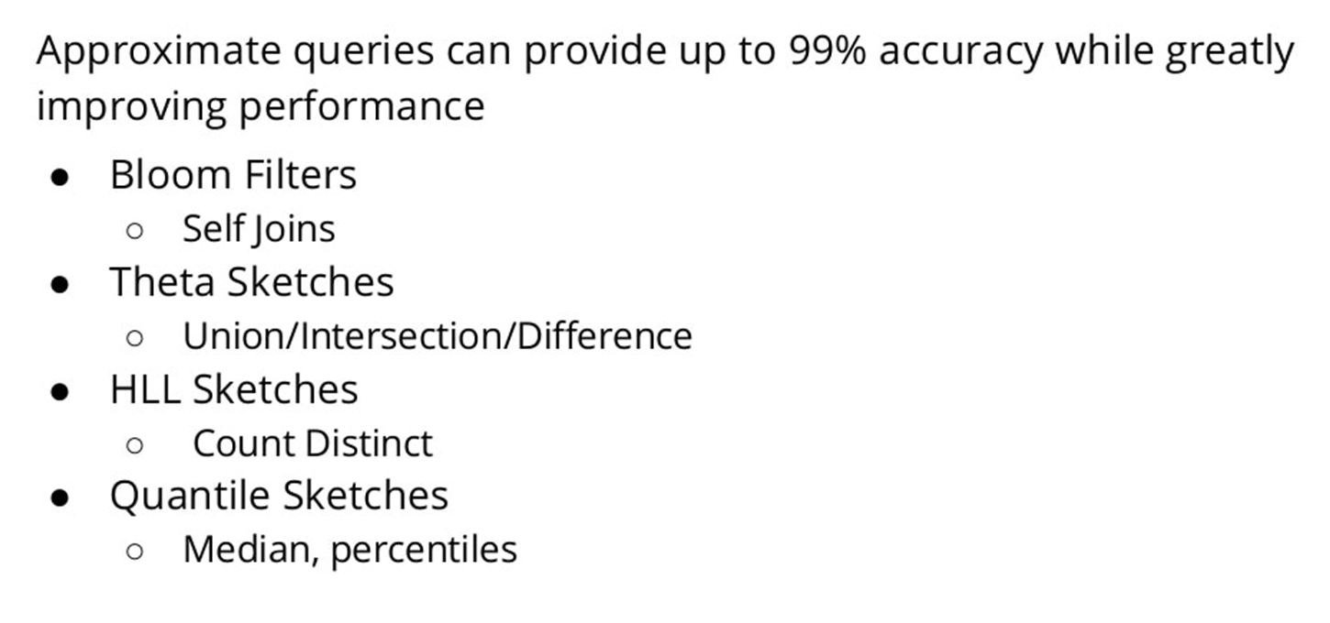
الگوریتم‌های تقریبی

Slide 42
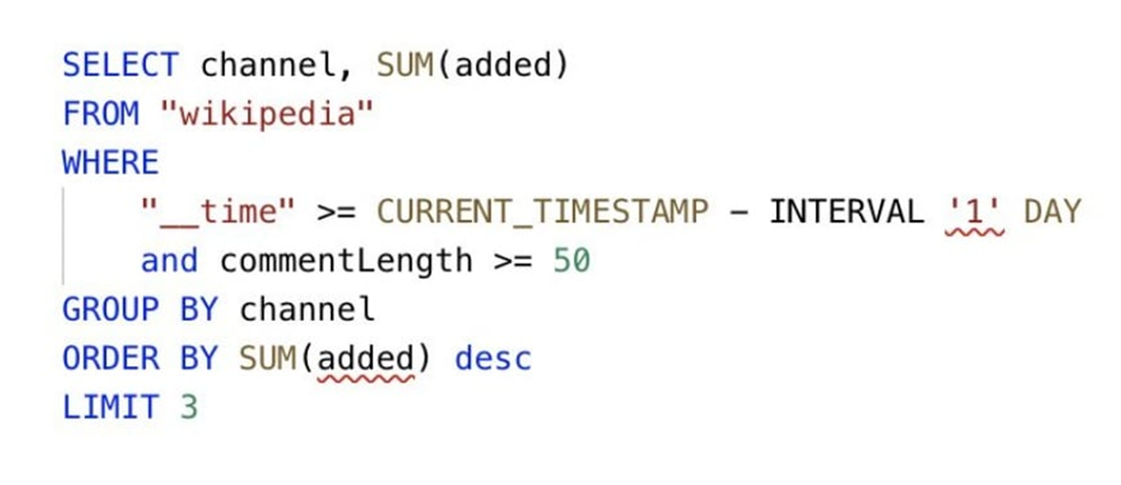
کوئری - SQL

Slide 43
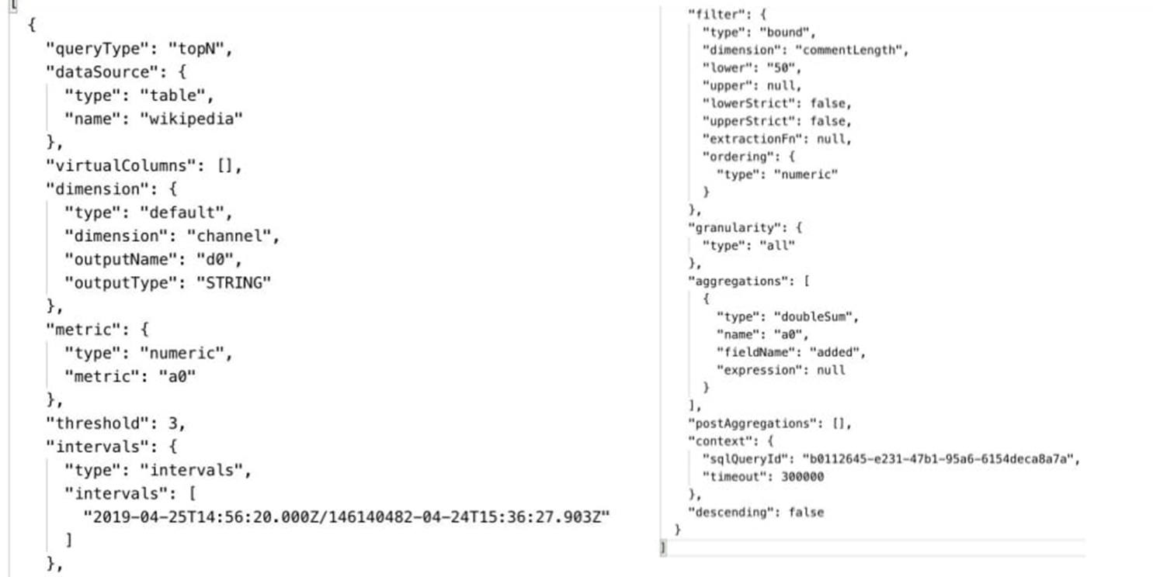
کوئری - Native Json

Slide 44
کوئری - Native Json

Slide 45
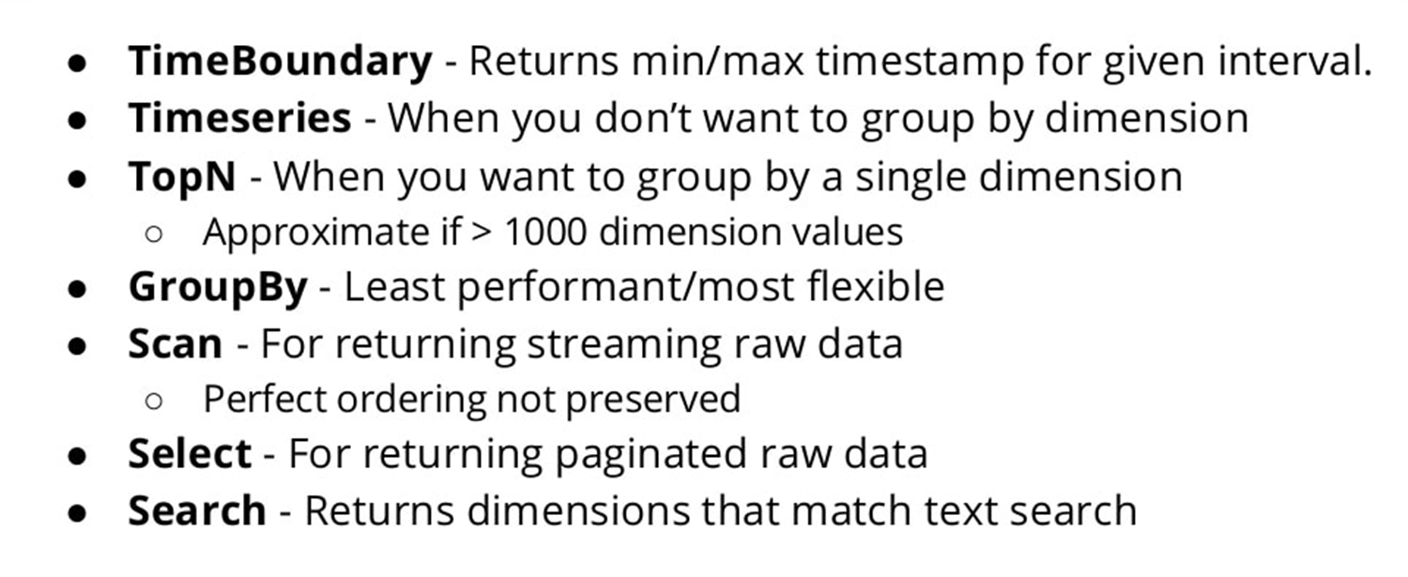
انواع کوئری در دروید

Slide 46
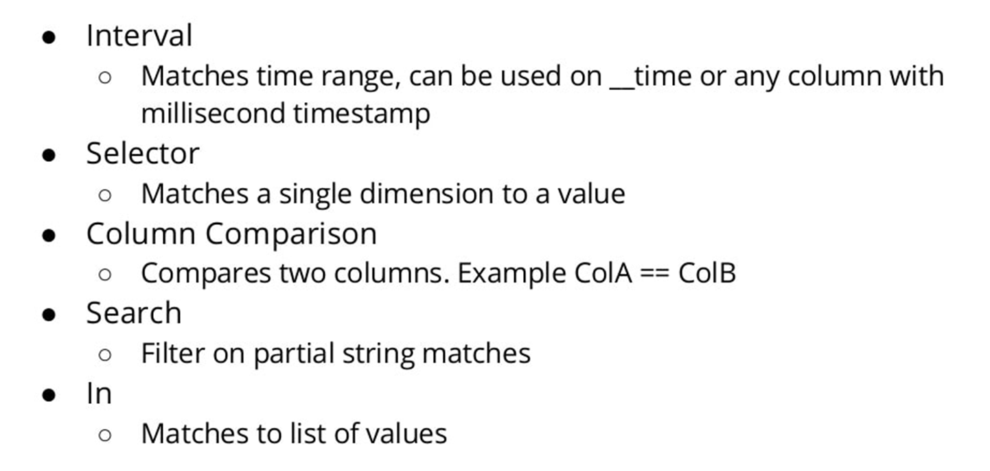
انواع فیلترها در دروید

Slide 47
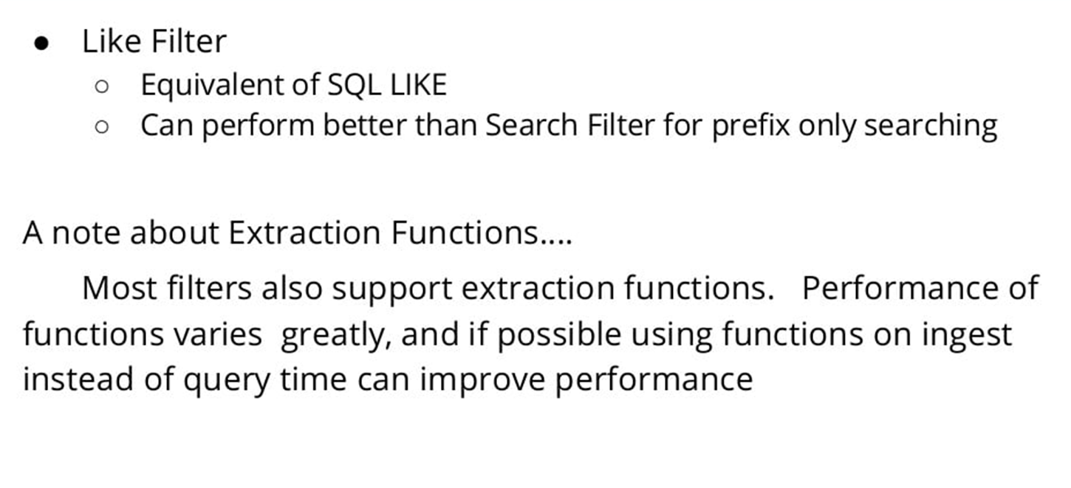
انواع فیلتر در دروید

Slide 48
When NOT to use Apache Druid
Despite Druid’s ability to process large amounts of data, there are situations where you would NOT want to use it:
Low-latency updates of existing records using a primary key. Druid supports streaming inserts, but not streaming updates (i.e., updates are done using background batch jobs).
Storing all the historical data in a raw format, without any aggregation or transformation.
Building an offline reporting system where query latency is not very important.
Queries that have “big” joins (joining one big fact table to another big fact table), where you’re comfortable with these queries taking a long time to complete.

Slide 49
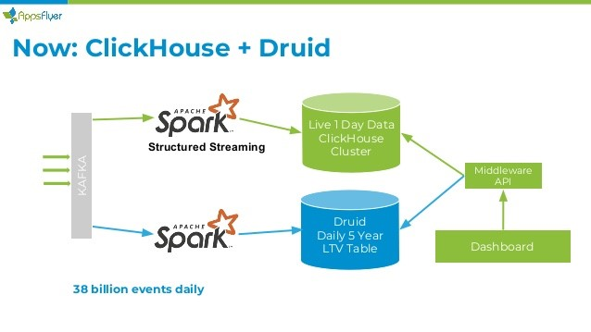
آخرین سخن

Slide 50
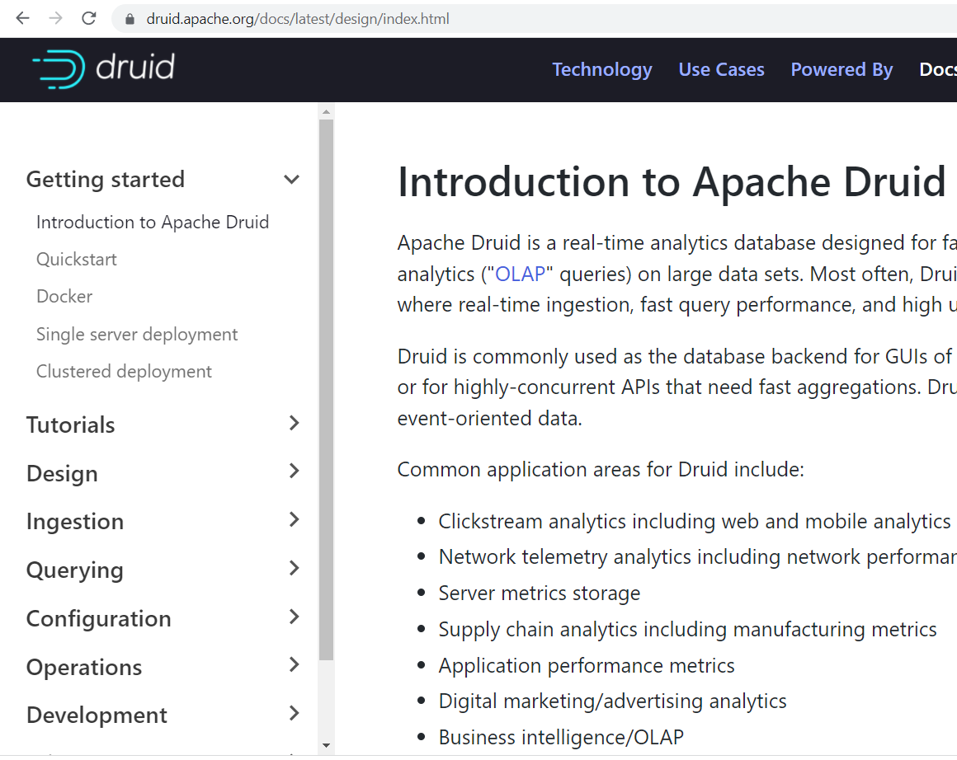
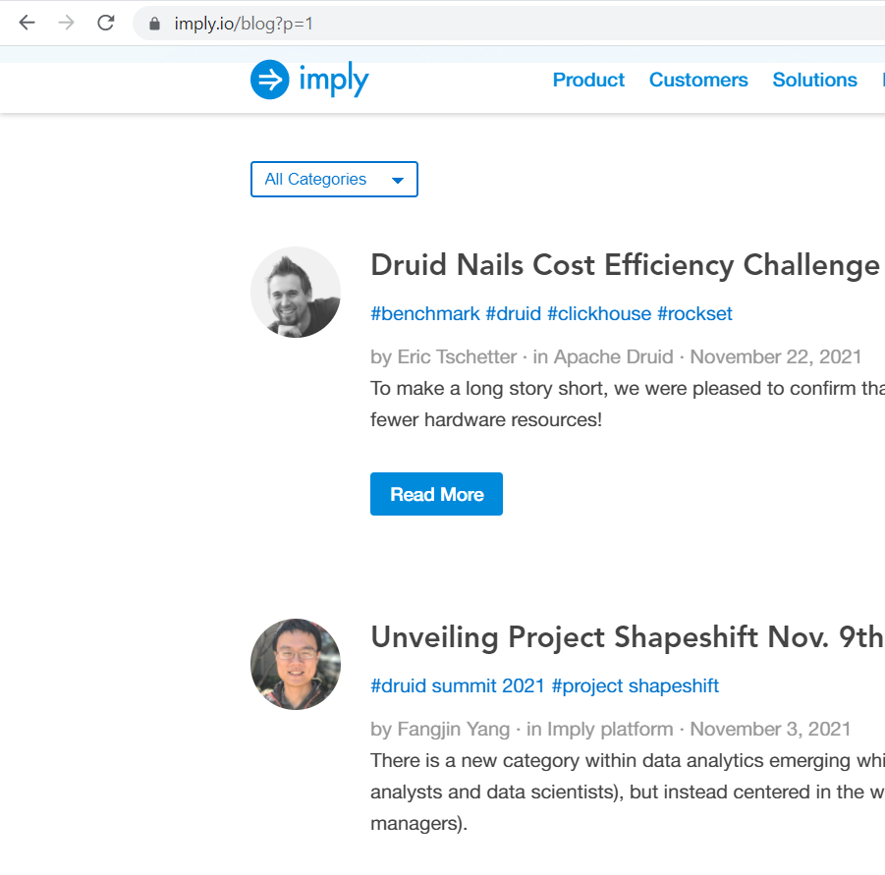
منابع آموزشی

Slide 51
کارگاه عملی
دانلود مخزن کد کارگاه
https://gitlab.com/nikamooz_bigdata/webinars
- نیاز به وی‌پی‌ان یا استفاده از خدمات shecan.ir خواهید داشت.

